Slide 1
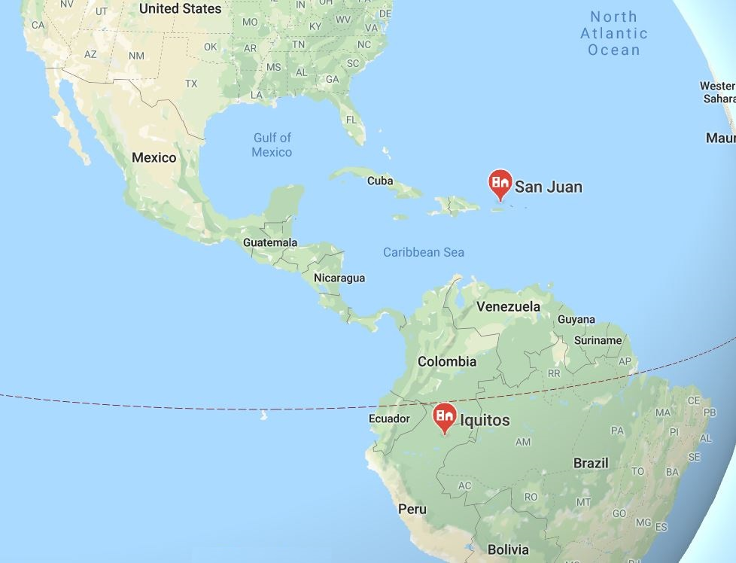
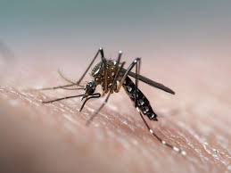
Dengue Prediction using EnSEMBLING Regression models

Slide 2
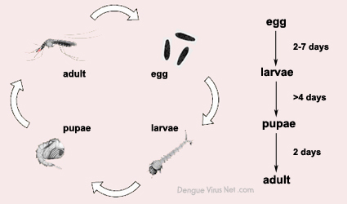
Objective : Predict the number of dengue fever cases that will be reported within a particular time span using the environmental data from San Juan and Iquitos cities.
Some known facts about Dengue :
Dengue is a viral disease transmitted by Aedes types of mosquitoes. Mosquitoes become infected with dengue after biting sick humans who have dengue virus in their blood. Between 8 and 12 days later if an infected mosquito bites someone else it can pass on the dengue virus.
Effects of weather factors on dengue fever
Temperature, rainfall and humidity have well-defined roles in the Dengue transmission cycle. Prolonged periods of heavy rain increase the opportunities for the diseases to spread. Longer seasons of mild temperatures may increase the transmission likelihood of dengue diseases.
Mosquito life cycle
The life cycle of Aedes aegypti can be completed within one-and-a-half to three weeks. Male mosquitoes live three to five days. The females live considerably longer, depending on how much warmth and moisture is in their environment. Under ideal conditions, they may last as long as a month or two.

Slide 3
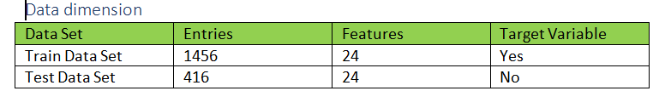
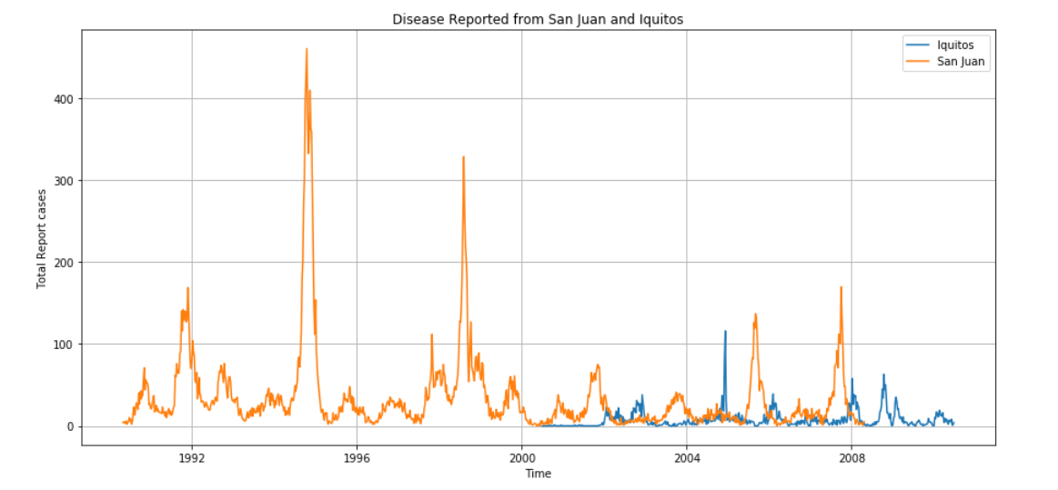
Datasets : The data has taken from DrivenData.
Meta Data:
city – Two cities namely San Juan and Iquitos
year- Years from 1990 to 2006
weekofyear – 52 weeks per year
reanalysis_precip_amt_kg_per_m2- precipitation amount
reanalysis_specific_humidity_g_per_kg- humidity amount
reanalysis_avg_temp_k. - average air temperature
reanalysis_max_air_temp_k- Max air temperature
reanalysis_min_air_temp_k- Min air temperature
total_cases- Total cases recorder per every week.

Slide 4
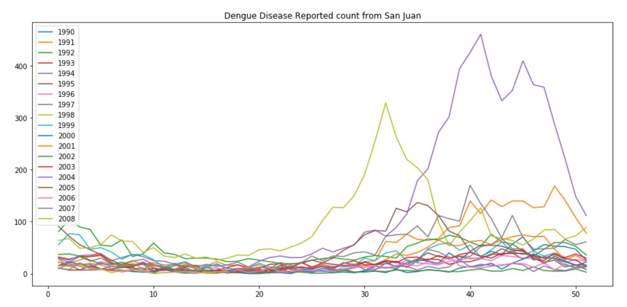
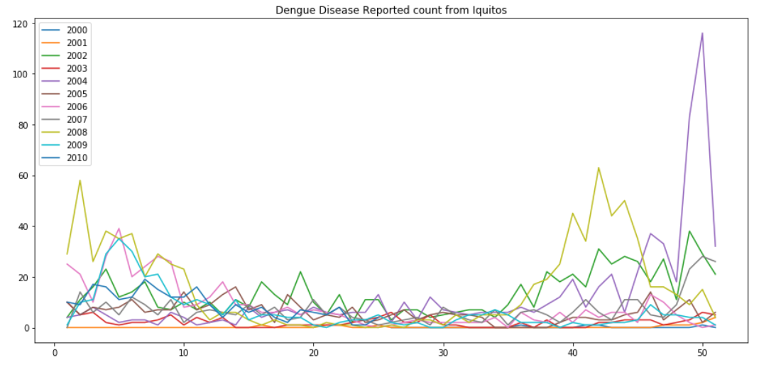
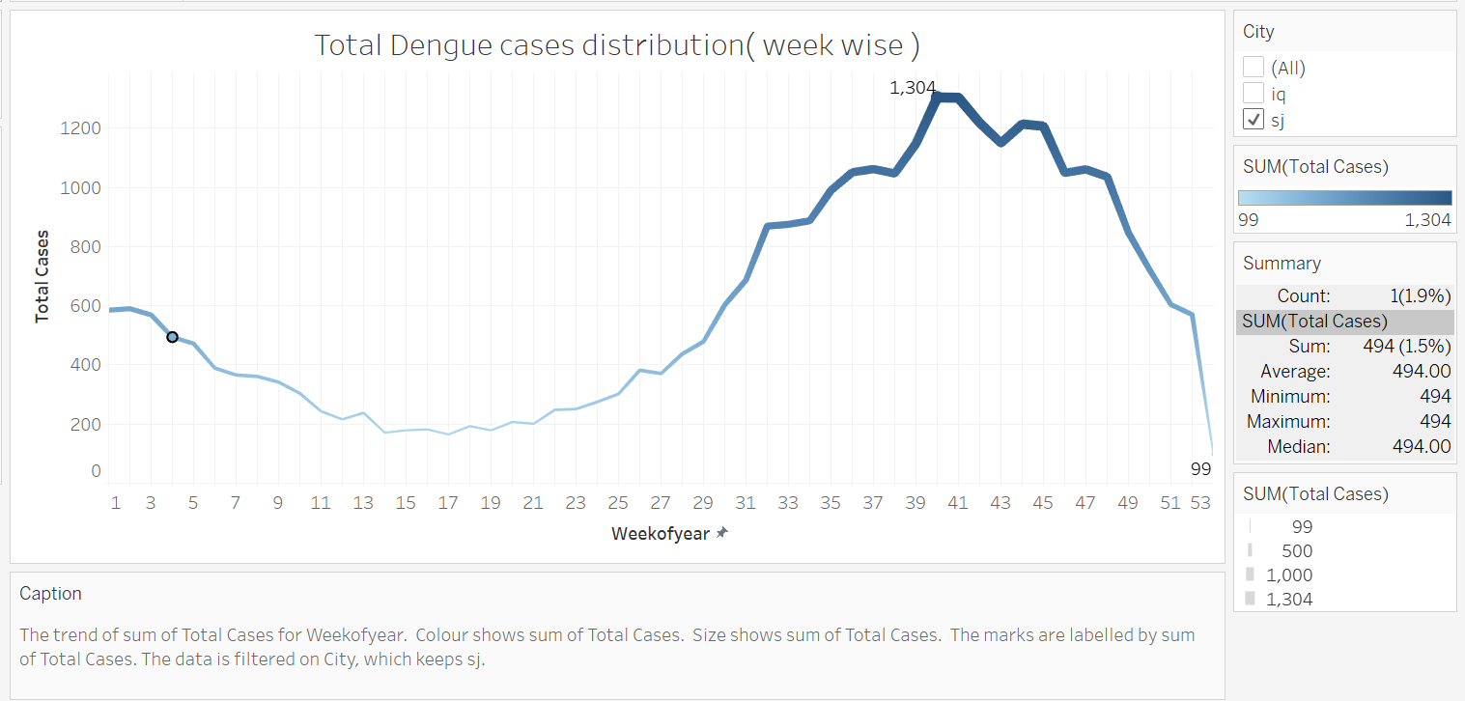
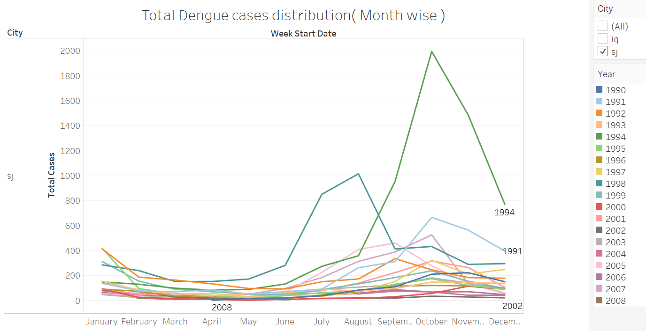
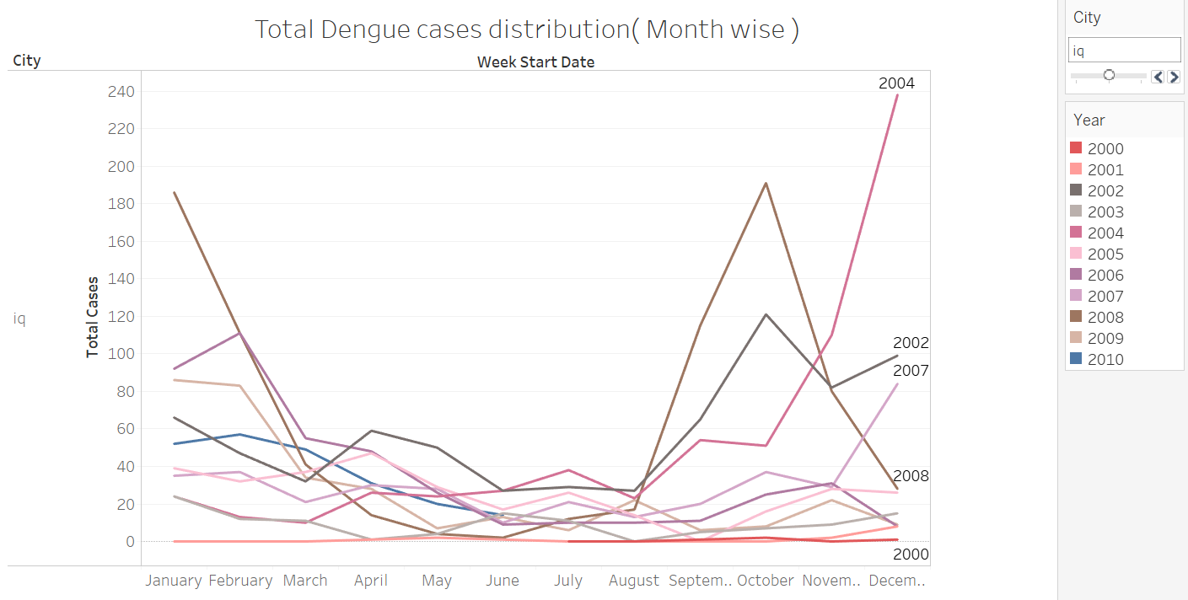
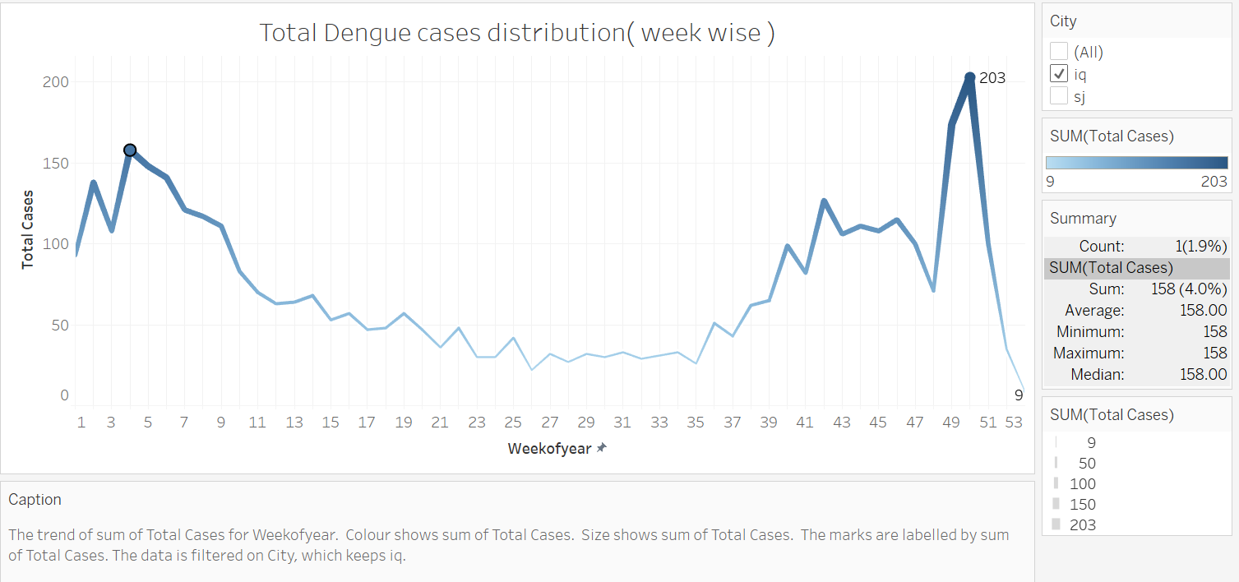
Year wise pattern
Week wise pattern
Month wise pattern

Slide 5
Work Flow of individual modelling
Lasso
Linear Regression
Data Exploration( data format, dimension, missing values, duplicate entries, descriptive analysis, correlation ... )
Data Visualization( Target variable distribution, year wise, month wise, week wise data distribution analysis)
New Feature Exploration ( Mean of vegetation , rolling lag window)
Separated the dataset for each city
Filling Missing Entries ( interpolate ), Unit-Conversion
Ridge
Negative Binomial Regression
Poisson Regression
ARIMA Regression
OLS Regression
Random Forest Regression
XGBoost Regression

Slide 6
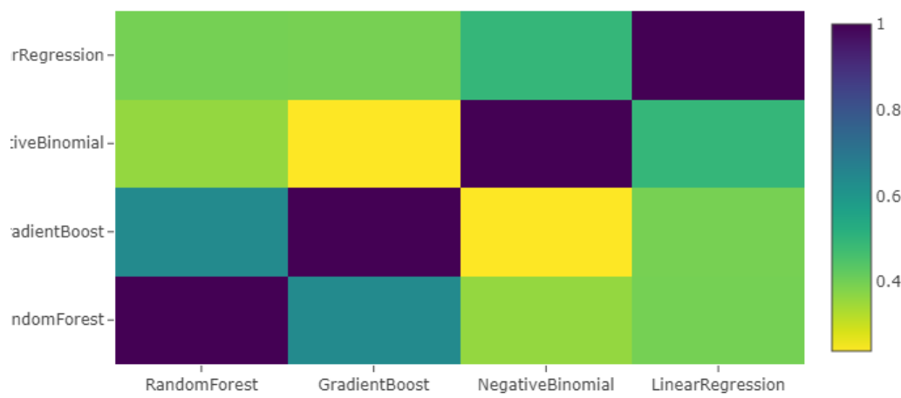
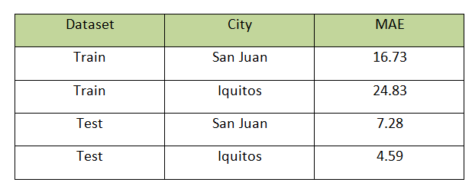
Stacking Ensemble
base level models
K Fold
combine
train
Linear Regression
Train O/p
Data frame
First level
output
train
Negative Binomial Regression
Train O/p
train
Random Forest Regression
Train O/p
train
XGBoost Regression
Train O/p
train
Train I/p
Test data
Test data O/p
XGBoost Regression (meta-model)
Test I/p
Train O/p
Test O/p

Slide 7
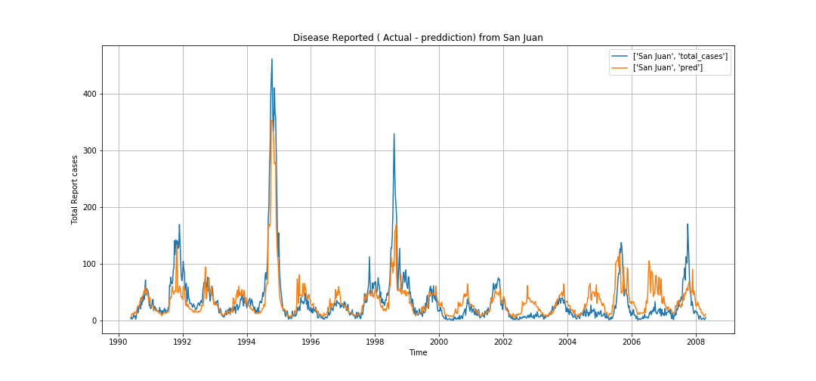
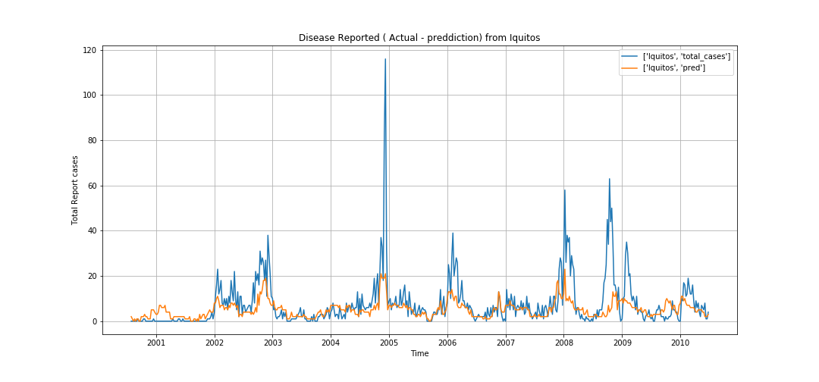
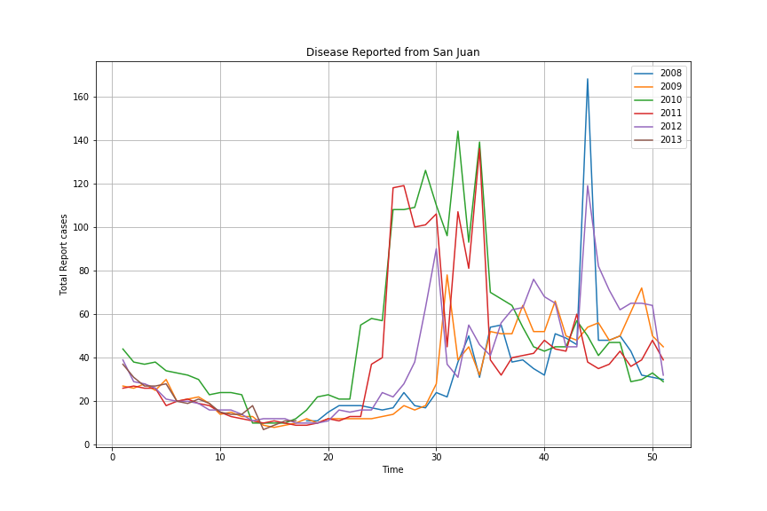
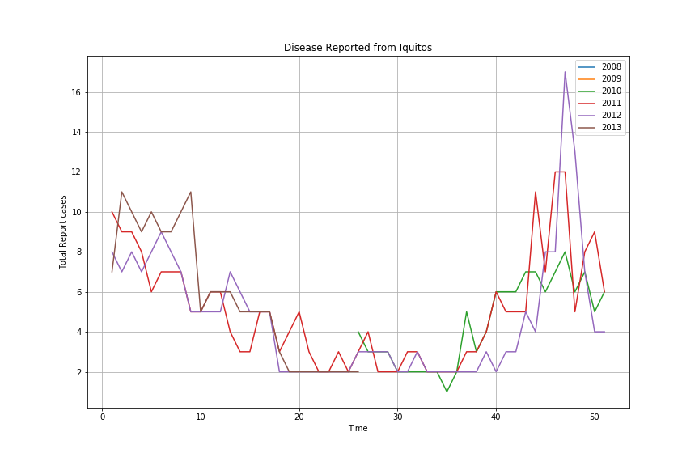
Best Model ( Random Forest ) Output prediction

Slide 8
Questions
Issues Faced
Over fitting the data - Got good validation scores in training, but same performance is not repeated in competition submission.
As per the media, there is dengue outbreak reported in San Juan 2010-2012. But models are not predicted the outbreaks, but just increased the reported cases count compared to previous years.
Future Areas of Work
Same window period was tried for all weather features. Instead of that, it should have been tried each lag window for each variable and fine tune it. Might be this may take time, but surely it will improve the model performance.
Currently we modelled for entire city. Instead of that, if separate datasets for north, south, west and east are available for each city, more accurate prediction will come.
Thank You

